Slide 1
C# for test automation
generic collections
Module 5

Slide 2
Agenda
Generics.
Practice 1. Create simple Generic class
Collections. How to choose a collection
Arrays
Practice 2. Arrays
Coffee break
Lists
Practice 3. Lists
Lunch
Dictionaries
Practice 4. Dictionaries
Coffee break
Delegates, anonymous methods, lambda expression
Func<>, Action<>, Predicate<>
Practice 5
Collection interfaces
Language-integrated query (LINQ)
Practice 6. LINQ
Repository pattern
Database transactions and using
References to null or transient value error

Slide 3
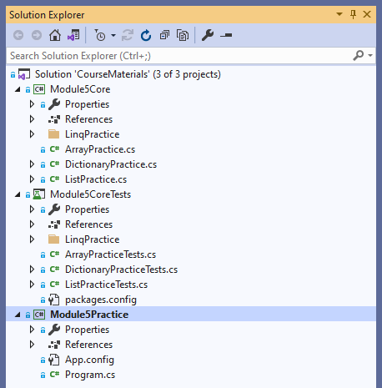
Project for hands on tasks
Clone following GIT repo:
https://github.com/d-okhrimenko/CSharpForTestAutomationMaterials.git
You will work in the mod5_initial branch in this module
Notes:
DEMO 1

Slide 4
Live demo
Initial state
class PairInt {
private readonly int _firstInt;
private readonly int _secondInt;
public PairInt(int firstInt, int secondInt) {
_firstInt = firstInt;
_secondInt = secondInt;
}
internal void Print() {
Console.WriteLine($"First number: {_firstInt}");
Console.WriteLine($"Second number: {_secondInt}");
}
}
class Program {
static void Main(string[] args) {
var pair = new PairInt(1, 5);
pair.Print();
}
}
Notes:
Initial state of the Console application for demo

Slide 5
Live demo
Demo 1
internal class Employee {
private readonly string _name;
public Employee(string name) {
_name = name;
}
public override string ToString() {
return _name;
}
}
static void Main(string[] args) {
var pair = new PairInt(1, 5);
pair.Print();
var firstEmployee = new Employee("Name1");
var secondEmployee = new Employee("Name2");
var pairEmployee = new PairEmployee(firstEmployee,
secondEmployee);
pairEmployee.Print();
}
internal class PairEmployee {
private readonly Employee _firstEmployee;
private readonly Employee _secondEmployee;
public PairEmployee(Employee firstEmployee, Employee secondEmployee) {
_firstEmployee = firstEmployee;
_secondEmployee = secondEmployee;
}
internal void Print() {
Console.WriteLine($"First number: {_firstEmployee}");
Console.WriteLine($"Second number: {_secondEmployee}");
} }
Notes:
Create Employee class with single property – Name
Create new PairEmployee class
Use it in the main program body
Logic inside Pair% classes are not type specific. Instead of duplicating class each time we could use generics instead

Slide 6
Generics
generics
static void Main(string[] args) {
…
var firstClass = new MyGenericClass<int>(1);
…
var secondClass = new MyGenericClass<string>("Second");
…
}
internal class MyGenericClass<T> {
public T Property { get; set; }
public MyGenericClass(T property) {
Property = property;
}
}
Notes:
Generics introduce the concept of type parameters to .NET, which make it possible to design classes and methods that defer the specification of one or more types until the class or method is declared and instantiated by client code. For example, by using a generic type parameter T, you can write a single class that other client code can use without incurring the cost or risk of runtime casts or boxing operations.
Generic classes and methods combine reusability, type safety, and efficiency in a way that their non-generic counterparts cannot. Generics are most frequently used with collections and the methods that operate on them. The System.Collections.Generic namespace contains several generic-based collection classes.
Of course, you can also create custom generic types and methods to provide your own generalized solutions and design patterns that are type-safe and efficient.
Generics overview
Use generic types to maximize code reuse, type safety, and performance.
The most common use of generics is to create collection classes.
The .NET class library contains several generic collection classes in the System.Collections.Generic namespace. These should be used whenever possible instead of classes such as ArrayList in the System.Collections namespace.
You can create your own generic interfaces, classes, methods, events, and delegates.
Generic classes may be constrained to enable access to methods on particular data types.
Information on the types that are used in a generic data type may be obtained at run-time by using reflection.

Slide 7
Generics
Constraints on type parameters
internal class MyGenericClass<T> where T : IMyInterface, new(){
public T Property { get; set; }
public MyGenericClass(T property) {
Property = property;
}
}
where T : IMyInterface – The type argument must be or implement specified interface
where T : new() – The type argument must have a public parameterless constructor
Other constrains
Notes:
Constraints specify the capabilities and expectations of a type parameter. Without any constraints, the type argument could be any type.
Declaring those constraints means you can use the operations and method calls of the constraining type. If your generic class or method uses any operation on the generic members beyond simple assignment or calling any methods not supported by System.Object, you'll have to apply constraints to the type parameter.

Slide 8
Live demo
Demo 1
public class Car<TEngine> where TEngine : class, TEngine, new() {
private TEngine _engine;
private string _model;
public Car(string model) {
_engine = new TEngine();
_model = model;
Console.WriteLine($"Car {model} with {typeof(TEngine)} engine created!");
}
public void Drive() {
Console.WriteLine($"Engine starts: {_engine.Start()}");
Console.WriteLine($"Now you're driving your {_model}!");
}
public IEngine GetEngine() {
return _engine;
}
}
public interface IEngine {
string Start();
}
public class V12Engine : IEngine {
public string Start() {
return "BR-BR-BR-BROOOOOOM!";
}
}
public class DieselEngine : IEngine {
public string Start() {
return "TRRR-TR-TR-TR-TR!";
}
}
static void Main(string[] args) {
var mercedesV12 = new Car<V12Engine>("Mercedes");
var volvoTruck = new Car<DieselEngine>("Volvo");
Console.WriteLine();
mercedesV12.Drive();
volvoTruck.Drive();
IEngine mercedesEngine = mercedesV12.GetEngine();
IEngine volvoEngine = volvoTruck.GetEngine();
Console.WriteLine();
Console.WriteLine(mercedesEngine.GetType());
Console.WriteLine(volvoEngine.GetType());
Console.WriteLine();
Console.ReadLine();
}
Notes:
Create GenericPair class
Replace all other Pair% classes with it and delete them
With generic classes its possible to reuse some not type specific code
DEMO 2

Slide 9


Generics
Practice 1
Changes for this practice should be done to Module5Core and Module5CoreTests projects
Create generic class MyGenericClass with generic property. Property value might be set via
user input constructor (or via 'set' property).
Create tests to check that it is possible to create instance of this class with the following property types:
  Value type : int
  Reference type : string
  Generic type : MyGenericClass<int>
You can use .ShouldBeOfType<int>() to perform check on type

Slide 10
Generics
Practice 1 - Solution
[TestClass()]
public class MyGenericClassTests {
[TestMethod()]
public void TestThatTypeCouldBeInteger() {
var obj = new MyGenericClass<int>(1);
obj.Property.ShouldBeOfType<int>();
}
[TestMethod()]
public void TestThatTypeCouldBeString() {
var obj = new MyGenericClass<string>(string.Empty);
obj.Property.ShouldBeOfType<string>();
}
[TestMethod()]
public void TestThatTypeCouldBeGenericType() {
var obj = new MyGenericClass<MyGenericClass<int>>(new MyGenericClass<int>(0));
obj.Property.ShouldBeOfType<MyGenericClass<int>>();
}
}
public class MyGenericClass<T> {
public T Property { get; }
public MyGenericClass(T property) {
Property = property;
}
}

Slide 11
What is a collection
collection
For many applications, you want to create and manage groups of related objects.
Collections are types that are designed to encapsulate a set of related objects together,
so that you can treat it as single collection object.
Arrays can be used as collection and are most useful for creating and working with a fixed number of strongly typed objects
Collections (List, Dictionary etc) provide a more flexible way to work with groups of objects. Unlike arrays, the group of objects you work with can grow and shrink dynamically as the needs of the application change
2 common ways
to group objects
arrays
of objects
collections
of objects
Notes:
A collection is a class, so you must declare an instance of the class before you can add elements to that collection.
If your collection contains elements of only one data type, you can use one of the classes in the System.Collections.Generic namespace. A generic collection enforces type safety so that no other data type can be added to it. When you retrieve an element from a generic collection, you do not have to determine its data type or convert it.

Slide 12
How to choose a collection
collection
Collection scenarios and classes which you need to you use will depend on your particular task
I want to… | Generic collection options | Non-generic collection options | Thread-safe or immutable collection options
Store items as key/value pairs for quick look-up by key | Dictionary<TKey,TValue> | Hashtable (A collection of key/value pairs that are organized based on the hash code of the key.) | ConcurrentDictionary<TKey,TValue> ReadOnlyDictionary<TKey,TValue> ImmutableDictionary<TKey,TValue>
Access items by index | List<T> | Array ArrayList | ImmutableList<T> ImmutableArray
Use items first-in-first-out (FIFO) | Queue<T> | Queue | ConcurrentQueue<T> ImmutableQueue<T>
Use data Last-In-First-Out (LIFO) | Stack<T> | Stack | ConcurrentStack<T> ImmutableStack<T>
Link to the table
Notes:
In general, you should use generic collections. The following table describes some common collection scenarios, and the collection classes you can use for those scenarios.

Slide 13
ArrayS
COLLection. ARRAYs
namespace System {
//
// Summary:
// Provides methods for creating, manipulating, searching, and sorting arrays, thereby
// serving as the base class for all arrays in the common language runtime.To browse
// the .NET Framework source code for this type, see the Reference Source.
[ComVisible(true)]
public abstract class Array : ICloneable, IList, ICollection, IEnumerable,
IStructuralComparable, IStructuralEquatable {
public bool IsFixedSize { get; }
public bool IsReadOnly { get; }
public bool IsSynchronized { get; }
public int Length { get; }
public long LongLength { get; }
public int Rank { get; }
public object SyncRoot { get; }
…
Notes:
Provides methods for creating, manipulating, searching, and sorting arrays, thereby serving as the base class for all arrays in the common language runtime.
The Array class is not part of the System.Collections namespaces. However, it is still considered a collection because it is based on the IList interface.
The Array class is the base class for language implementations that support arrays. However, only the system and compilers can derive explicitly from the Array class. Users should employ the array constructs provided by the language.

Slide 14
ArrayS
definitions
Elements: The individual data items of an array are called elements. All elements of an array
must be of the same type or derived from the same type.
Rank/dimensions: Arrays can have any positive number of dimensions.
The number of dimensions an array has is called its rank
Dimension length: Each dimension of an array has a length, which is the number of positions
in that direction
Array length: The total number of elements contained In the array, in all dimensions
0 | 0 | 0 | 0 | 0
0 | O | 0 | 0 | 0
0 | 0 | 0 | 0 | 0
0 | 0 | 0 | 0 | 0
Notes:
Q: Could this table be considered as an array?

Slide 15
Live demo
Demo 1
static void Main(string[] args) {
var numbers = new int[5];
numbers[0] = 1;
numbers[1] = 2;
numbers[2] = 3;
numbers[3] = 4;
numbers[4] = 5;
// numbers[5] = 6;
numbers = new[] { 1, 2, 3, 4, 5 };
// var arrayMulti = new int[] { 1, 1 };
//var arrayMulti = new int[,] { { 1, 1 }, { 1, 1 } };
var arrayMulti = new int[,,] { { { 1, 1 }, { 1, 1 } },
{ { 1, 1 }, { 1, 1 } } };
Console.WriteLine(numbers.Length);
Console.WriteLine($"Before: {string.Join(" ",numbers)}");
Array.Reverse(numbers);
Console.WriteLine($"After: {string.Join(" ",numbers)}");
}

Slide 16
Array summary
COLLection. arrays
An array can be Single-Dimensional or Multidimensional
The number of dimensions and the length of each dimension are established
When the array instance is created, this values can't be changed during the lifetime of the instance
The default values of numeric array elements are set to zero, and reference elements are set to null
Arrays are zero indexed: an array with n elements is indexed from 0 to n-1
Array elements can be of any type, including an array type
Array types are reference types derived from the abstract base type Array

Slide 17
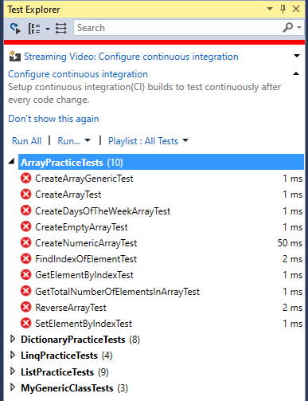
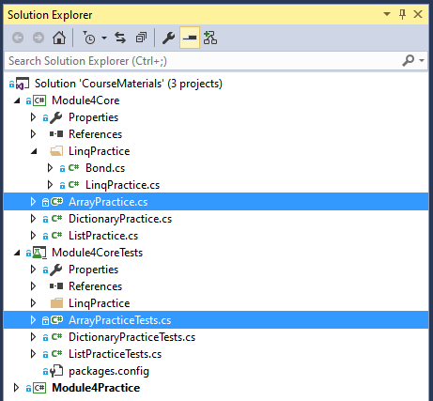
arrays
Practice 2
Provide implementations for methods in ArrayPractice
After methods have been filled in with implementation
unit tests from ArrayPracticeTests should no longer fail

Slide 18
arrays
Practice 2 - solution
public static class ArrayPractice {
public static int[] CreateArray(int numberOfElements) => new int[numberOfElements];
public static T[] CreateArrayGeneric<T>(int numberOfElements) => new T[numberOfElements];
public static int[] CreateNumericArray() => new[] { 1, 2, 3, 4, 5 };
public static string[] CreateDaysOfTheWeekArray() => new[] { "Monday", "Tuesday", "Wednesday", "Thursday",
"Friday", "Saturday", "Sunday" };
public static int GetTotalNumberOfElementsInArray<T>(T[] array) => array.Length;
public static T GetElementByIndex<T>(T[] array, int index) => array[index];
public static void SetElementByIndex(int[] array, int index, int element) {
array[index] = element;
}
public static int[] CreateEmptyArray() => Array.Empty<int>();
public static void ReverseArray<T>(T[] array) {
Array.Reverse(array);
}
public static int FindIndexOfElement<T>(T[] array, T element) => Array.IndexOf(array, element);
}

Slide 19

Coffee Break

Slide 20
Lists
COLLection. lists
namespace System.Collections.Generic {
//
// Summary:
// Represents a strongly typed list of objects that can be accessed by index. Provides
// methods to search, sort, and manipulate lists.To browse the .NET Framework source
// code for this type, see the Reference Source.
public class List<T> : IList<T>, ICollection<T>, IEnumerable<T>, IEnumerable, IList,
ICollection, IReadOnlyList<T>, IReadOnlyCollection<T> {
public List();
public List(int capacity);
public List(IEnumerable<T> collection);
public T this[int index] { get; set; }
…

Slide 21
Live demo
Demo 2
var numbers = new List<int>();
// var numbers = new List<int>(500);
numbers.Add(1);
numbers.Add(2);
numbers.Add(3);
numbers.Add(4);
numbers.Add(5);
Console.WriteLine($"Capacity: {numbers.Capacity}");
Console.WriteLine($"Count: {numbers.Count}");
numbers.Add(1);
numbers.Add(2);
numbers.Add(3);
numbers.Add(4);
numbers.Add(5);
Console.WriteLine($"Capacity: {numbers.Capacity}");
Console.WriteLine($"Count: {numbers.Count}");
numbers.Add(3);
numbers.Add(4);
numbers.Add(5);
Console.WriteLine($"Capacity: {numbers.Capacity}");
Console.WriteLine($"Count: {numbers.Count}");

Slide 22
Live demo
Demo 2
var numbers = new List<int>() { 1, 2, 3 };
Console.WriteLine($"Capacity: {numbers.Capacity}");
Console.WriteLine($"Count: {numbers.Count}");
Console.WriteLine($"Before: {string.Join(" ", numbers)}");
numbers.Reverse();
Console.WriteLine($"After: {string.Join(" ", numbers)}");
int index = numbers.IndexOf(2);
numbers[index] = 42;
numbers.RemoveAt(index);
Console.WriteLine($"List: {string.Join(" ", numbers)}");

Slide 23
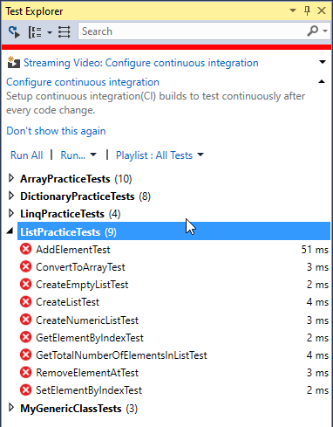
Lists
Practice 3
Provide implementations for methods in ListPractice
After methods have been filled in with implementation unit tests from ListPracticeTests
should no longer fail

Slide 24
Lists
Practice 3 - solution
public static class ListPractice {
public static List<T> CreateEmptyList<T>() {
return new List<T>();
}
public static List<T> CreateList<T>(T[] array) {
return new List<T>(array);
}
public static List<int> CreateNumericList() {
return new List<int> { 1, 2, 3, 4, 5 };
}
public static int GetTotalNumberOfElementsInList<T>(List<T> list) {
return list.Count;
}
public static T GetElementByIndex<T>(List<T> list, int index) {
return list[index];
}
public static void SetElementByIndex<T>(List<T> list, int index, T element) {
list[index] = element;
}
public static void AddElement<T>(List<T> list, T element) {
list.Add(element);
}
public static void RemoveElementAt<T>(List<T> list, int index) {
list.RemoveAt(index);
}
public static T[] ConvertToArray<T>(List<T> list) {
return list.ToArray();
}
}

Slide 25
Dictionaries
COLLection. dictionaries
namespace System.Collections.Generic {
//
// Summary:
// Represents a collection of keys and values.To browse the .NET Framework source
// code for this type, see the Reference Source.
public class Dictionary<TKey, TValue> : IDictionary<TKey, TValue>,
ICollection<KeyValuePair<TKey, TValue>>, IEnumerable<KeyValuePair<TKey, TValue>>,
IEnumerable, IDictionary, ICollection, IReadOnlyDictionary<TKey, TValue>,
IReadOnlyCollection<KeyValuePair<TKey, TValue>>,
ISerializable, IDeserializationCallback {
public Dictionary();
public Dictionary(int capacity);
…
Notes:
https://www.codeproject.com/Articles/598866/KnowplusThyplus-NETplusDictionaries
A dictionary is a data structure which provides a one-way association between two object instances, or put more simply, it allows you to say that for one specific thing you want to be able to get another specific thing
The thing we’re mapping from is called the Key and the thing it maps to the Value. Most dictionaries use a hash table algorithm under the covers. For these, the value can be anything but keys must do two things:
Provide an equality method, a way in which we can tell if two objects are the same thing. For people, we might say that if two instances share the same first name, last name and date of birth, we consider them as representing the same real person. Better yet, we could compare National Insurance numbers (or Social Security numbers if you prefer) or a database identifier if we have one as these already have the concept of uniqueness ingrained in them.
Provide a hash code based upon the fields we’ve identified as defining uniqueness, i.e., the same fields we used for equality. A hash code in the case of a .NET dictionary is simply a single integer number. That’s single as in just one, not 16 bits.
In essence, a hash table works by having a set of buckets (typically) slightly larger in quantity than the number of items. Each key/value pair is placed in a bucket and it uses the hash code of the key to determine which bucket that is (or would be). Depending on implementation buckets can hold one key/value pair or more than one.

Slide 26
Live demo
Demo 3
var numbers = new Dictionary<int, string>()
{ { 1, "One" }, { 2, "Two" }, { 3, "Three" } };
numbers.Add(5, "Five");
//numbers.Add(5,"Five");
//numbers.Add(6,"Five");
Console.WriteLine($"Dictionary: {string.Join(" ", numbers)}");
Console.WriteLine($"Five: {numbers[5]}");
string value;
numbers.TryGetValue(5, out value);
Console.WriteLine($"Five: {value}");
numbers.Remove(5);
Console.WriteLine($"Dictionary: {string.Join(" ", numbers)}");

Slide 27
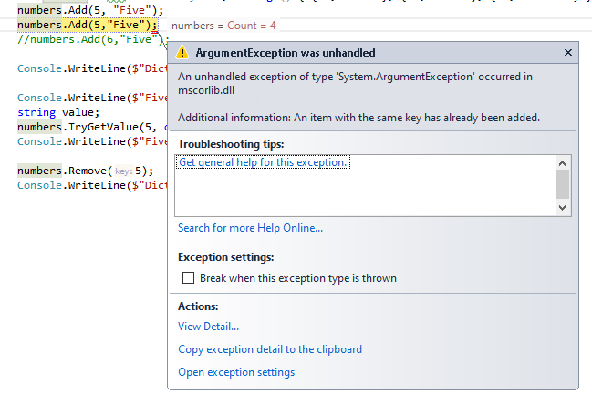
Live demo
Demo 3
Notes:
The Dictionary<TKey,TValue> generic class provides a mapping from a set of keys to a set of values. Each addition to the dictionary consists of a value and its associated key. Retrieving a value by using its key is very fast, close to O(1), because the Dictionary<TKey,TValue> class is implemented as a hash table.
As long as an object is used as a key in the Dictionary<TKey,TValue>, it must not change in any way that affects its hash value. Every key in a Dictionary<TKey,TValue> must be unique according to the dictionary's equality comparer. A key cannot be null, but a value can be, if its type TValue is a reference type.
Dictionary<TKey,TValue> requires an equality implementation to determine whether keys are equal. You can specify an implementation of the IEqualityComparer<T> generic interface by using a constructor that accepts a comparer parameter; if you do not specify an implementation, the default generic equality comparer EqualityComparer<T>.Default is used. If type TKey implements the System.IEquatable<T> generic interface, the default equality comparer uses that implementation.

Slide 28
Live demo
Demo 3
var dictionary = new Dictionary<Employee, int>() {
{ new Employee("Serhii"), 1 }, {new Employee("Serhii"),2 }
};
foreach (KeyValuePair<Employee, int> keyValuePair in dictionary) {
Console.WriteLine(keyValuePair);
}
internal class Employee : IEquatable<Employee> {
private readonly string _name;
…

Slide 29

LUNCH

Slide 30
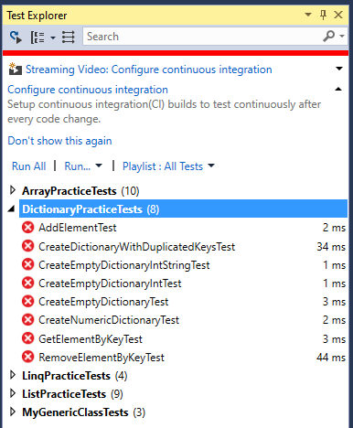
dictionaries
Practice 4
Provide implementations for methods in DictionaryPractice
After methods have been filled in with implementation unit tests from DictionaryPracticeTests
should no longer fail

Slide 31
dictionaries
Practice 4 - solution
public static class DictionaryPractice {
public static Dictionary<int, int> CreateEmptyDictionaryInt() {
return new Dictionary<int, int>();
}
public static Dictionary<int, string> CreateEmptyDictionaryIntString() {
return new Dictionary<int, string>();
}
public static Dictionary<TKey, TValue> CreateEmptyDictionary<TKey, TValue>() {
return new Dictionary<TKey, TValue>();
}
public static Dictionary<int, string> CreateNumericDictionary() {
return new Dictionary<int, string> { { 1, "One" }, { 2, "Two" } , {3,"Three"} };
}
public static Dictionary<int, string> CreateDictionaryWithDuplicatedKeys() {
return new Dictionary<int, string> { {1,"One" }, {1,"Two"} };
}
public static TValue GetElementByKey<TKey, TValue>(Dictionary<TKey, TValue> dictionary, TKey key) {
TValue element;
dictionary.TryGetValue(key, out element);
return element;
}
public static void AddElement<TKey, TValue>(Dictionary<TKey,TValue> dictionary, TKey key,TValue element) {
dictionary.Add(key,element);
}
public static void RemoveElementByKey<TKey, TValue>(Dictionary<TKey, TValue> dictionary, TKey key) {
dictionary.Remove(key);
}
}

Slide 32
Delegates, anonymous methods, lambda expressions
A delegate is a type that represents references to methods with particular parameters and return type
public delegate double Del(int number);
The following example declares a delegate named Del that can encapsulate a method that takes number int as an argument and returns double:
Any method from any accessible class or struct that matches the delegate type can be assigned to the delegate.
Notes:
The method can be either static or an instance method.
https://www.youtube.com/watch?v=nmG9Re7HK60&ab_channel=AngelSix
https://docs.microsoft.com/en-us/dotnet/csharp/programming-guide/delegates/

Slide 33
Delegates, anonymous methods, lambda expressions
Delegates have the following properties:
Delegates allow methods to be passed as parameters.
Delegates can be used to define callback methods.
Delegates can be chained together; for example, multiple methods can be called on a single event.
Methods don't have to match the delegate type exactly. For more information, see Using Variance in Delegates.

Slide 34
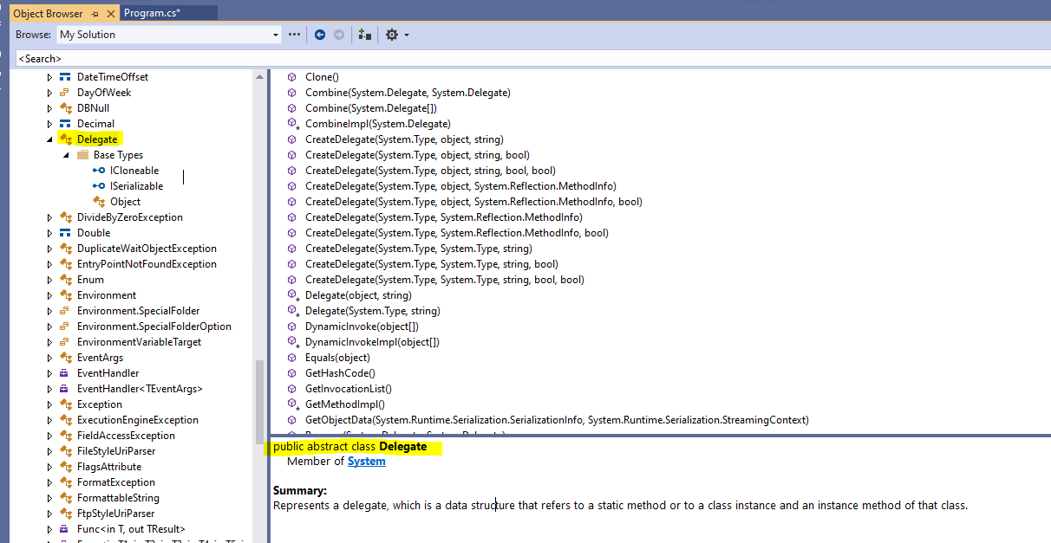
Delegates, anonymous methods, lambda expressions
The Delegate class is the base class for delegate types. However, only the system and compilers can derive explicitly from the Delegate class or from the MulticastDelegate class. It is also not permissible to derive a new type from a delegate type. The Delegate class is not considered a delegate type; it is a class used to derive delegate types.
Notes:
https://docs.microsoft.com/en-us/dotnet/api/system.delegate?view=net-6.0

Slide 35
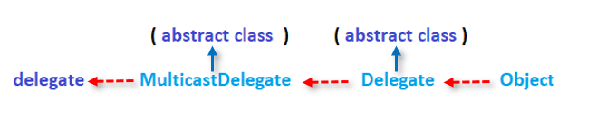
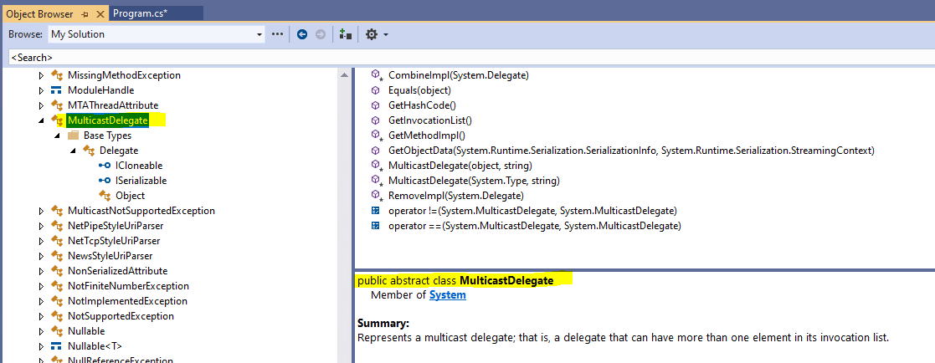
Delegates, anonymous methods, lambda expressions
MulticastDelegate is a special class. Compilers and other tools can derive from this class, but you cannot derive from it explicitly. The same is true of the Delegate class.
Notes:
https://docs.microsoft.com/en-us/dotnet/api/system.m
A MulticastDelegate has a linked list of delegates, called an invocation list, consisting of one or more elements. When a multicast delegate is invoked, the delegates in the invocation list are called synchronously in the order in which they appear. If an error occurs during execution of the list then an exception is thrown/

Slide 36
Delegates, anonymous methods, lambda expressions
Live demo - delegate
public delegate double Del(int number);
// Create a method for a delegate.
public static double NormalMethod(int number) {
return number * 2.0;
}
// Creates an instance of delegate
Del myDelegate = new Del(NormalMethod);
// Call the delegate.
myDelegate(4);

Slide 37
Delegates, anonymous methods, lambda expressions
Live demo - delegate
public delegate double Del(int number);
// accept a method (delegate) as an input
public static double RunOtherMethod(Del myDel, int number) {
myDel(message);
}
// Creates an instance of delegate
Del myDelegate = new Del(NormalMethod);
//pass a delegate as a variable
double otheresult = RunOtherMethod(myDelegate, 4);

Slide 38
Delegates, anonymous methods, lambda expressions
Live demo – anonymous method
//anonymous method is delegate and returns a delegate
Del anonymousMyDelegate = delegate(int number) { return number * 2.0; };
This is identical to
Del myDelegate = new Del(NormalMethod);
//call a method
double anonymousResult = anonymousMyDelegate(4);

Slide 39
Delegates, anonymous methods, lambda expressions
Live demo – Lambda expression
Lambda expression is an anonymous method that can be used to create delegates
//anonymous method is delegate and returns a delegate
Del anonymousMyDelegate = delegate(int number) { return number * 2.0; };
//lambda expressions are anything with => and right/left value
// they return a delegate so a method that can be invoked
Del lambdaMyDelegate = number => number * 2.0;
double lambdaResult = lambdaMyDelegate(4);
//nicer way to write a lambda
Del nicerlambdaMyDelegate = (number) => {
return number * 2.0;
};
double nicerlambdaResult = nicerlambdaMyDelegate(4);

Slide 40
Delegates, anonymous methods, lambda expressions
Action
Encapsulates a method that has no parameters and does not return a value.
public delegate void Action();
Encapsulates a method that has a single parameter and does not return a value.
public delegate void Action<in T>(T obj);
Encapsulates a method that has two parameters and does not return a value
public delegate void Action<in T1, in T2>(T1 arg1, T2 arg2);
Action myAction = () => { Console.WriteLine("Hello"); };
Action<string> myAction2 = name => { Console.WriteLine($"Hello {name}"); };
Action<string, string> myAction3 = (name, surname) => { Console.WriteLine($"Hello {name} {surname}"); };
//run a delegate
myAction();
myAction2("Maria");
myAction3("Maria", "Ivanenko");

Slide 41
Delegates, anonymous methods, lambda expressions
FUNC
Encapsulates a method that has no parameters and returns a value of the type specified by the TResult parameter.
public delegate TResult Func<out TResult>();
Encapsulates a method that has one parameter and returns a value of the type specified by the TResult parameter.
public delegate TResult Func<in T, out TResult>(T arg);
Encapsulates a method that has two parameters and returns a value of the type specified by the TResult parameter.
public delegate TResult Func<in T1, in T2, out TResult>(T1 arg1, T2 arg2);
Func<int> func = () => 2;
Func<int, double> func2 = number => 2.0 * number;
Func<int, int, double> func3 = (number1, number2) => 2.0 * number1 * number2;
//run a delegate
int fucnresult = func();
double func2result = func2(4);
double fucn3result = func3(4, 4);

Slide 42
Delegates, anonymous methods, lambda expressions
PREDICATE
Represents the method that defines a set of criteria and determines whether the specified object meets those criteria.
public delegate bool Predicate<in T>(T obj);
Finds whether list sum is greater than or equal then 10
Predicate<List<int>> predicate = x => x.Sum(element => element) >= 10;
//run a delegate
predicate(new List<int> { 1, 2, 3, 4 });

Slide 43
Delegates, anonymous methods, lambda expressions
PRACTICE 5
  Using a Calculate method
public static double Calculate(Func<double, int, double> func, double number1,
int number2) {
return func(number1, number2);
}
Calculate sum, division and multiplication of two numbers.
Do not forget about division by zero.
You can test on different number1, number2, for example number1 = 10.1, number2 = 30;
2. Using a Predicate delegate check:
var list = new List<int>() { 4, 5, 6, 8, 9 };
Whether list is not empty;
Whether sum of odd numbers is greater than sum of even numbers for list.

Slide 44
Delegates, anonymous methods, lambda expressions
PRACTICE 5 - SOLUTION
1.
double multiplication = Calculate((number1, number2) => number1 * number2, 10.1, 30);
double addition = Calculate((number1, number2) => number1 + number2, 10.1, 30);
double division = Calculate(Divide, 10.1, 30);
private static double Divide(double number1, int number2) {
if (number2 == 0) {
return 1;
}
return number1 / number2;
}
2. a) Predicate<List<int>> predicate1 = x => x.Any();
bool isnotemptylist = predicate1(list);
b) Predicate<List<int>> predicate = x => {
int evensum = x.Where(element => element % 2 == 0).Sum(element => element);
int oddsum = x.Sum(element => element) - evensum;
return oddsum > evensum;
};
bool greater = predicate(list);

Slide 45
Coffee Break

Slide 46
Collection interfaces
COLLection interfaces
IList<T>
ICollection<T>
IEnumerable<T>
Iterate over a collection
Iterate over a collection
Iterate over a collection
Add elements
Add elements
Remove elements
Remove elements
Accesses by index

Slide 47
Live demo
Live demo 4
static void Main(string[] args) {
IEnumerable<int> collection = new List<int>(){1,2,3,4,5};
//ICollection<int> collection = new List<int>(){1,2,3,4,5};
//IList<int> collection = new List<int>(){1,2,3,4,5};
foreach (int element in collection) {
Console.WriteLine(element);
}
//collection.Add(42);
//collection.Remove(42);
//collection[0] = 42;
}
Notes:
Represents a collection of objects that can be individually accessed by index.

Slide 48
Live demo
Demo 4
class Program {
static void Main(string[] args) {
Employee[] employees = GetEmployees();
Array.Sort(employees, new EmployeeComparer());
for (var index = 0; index < 5; index++) {
var employee = employees[index];
Console.WriteLine(employee);
}
}
private static Employee[] GetEmployees() {
return new Employee[] {
new Employee("Name 9"),
new Employee("Name 7"),
new Employee("Name 8"),
new Employee("Name 6"),
new Employee("Name 2"),
new Employee("Name 5"),
new Employee("Name 9"),
new Employee("Name 3"),
new Employee("Name 4"),
new Employee("Name 1"),
};
}
}
class EmployeeComparer : IComparer<Employee> {
public int Compare(Employee x, Employee y) {
return String.CompareOrdinal(x.Name, y.Name);
}

Slide 49
Language-Integrated Query (LINQ)
linq
Language-Integrated Query (LINQ) is the name for a set of technologies based on the integration of query capabilities directly into the C# language.
LINQ queries offer three main advantages over traditional foreach loops:
They are more concise and readable, especially when filtering multiple conditions.
They provide powerful filtering, ordering, and grouping capabilities with a minimum of application code.
They can be ported to other data sources with little or no modification.
In general, the more complex the operation you want to perform on the data, the more benefit you'll realize by using LINQ instead of traditional iteration techniques.
Notes:
Traditionally, queries against data are expressed as simple strings without type checking at compile time or IntelliSense support. Furthermore, you have to learn a different query language for each type of data source: SQL databases, XML documents, various Web services, and so on. With LINQ, a query is a first-class language construct, just like classes, methods, events. You write queries against strongly typed collections of objects by using language keywords and familiar operators. The LINQ family of technologies provides a consistent query experience for objects (LINQ to Objects), relational databases (LINQ to SQL), and XML (LINQ to XML).
For a developer who writes queries, the most visible "language-integrated" part of LINQ is the query expression. Query expressions are written in a declarative query syntax. By using query syntax, you can perform filtering, ordering, and grouping operations on data sources with a minimum of code. You use the same basic query expression patterns to query and transform data in SQL databases, ADO.NET Datasets, XML documents and streams, and .NET collections.
In a basic sense, LINQ to Objects represents a new approach to collections. In the old way, you had to write complex foreach loops that specified how to retrieve data from a collection. In the LINQ approach, you write declarative code that describes what you want to retrieve.

Slide 50
Query Syntax
linq
//Data source
IEnumerable<Person> persons = new Person[]{…};
// Define the query
IEnumerable<Person> personsQuery =
from person in persons
where person.FirstName.StartsWith("A") &&
person.LastName.Length > 7
select person;
foreach (Person person in personsQuery) {
// ...
}
Notes:
Query syntax must be translated into method calls for the .NET common language runtime (CLR) when the code is compiled. These method calls invoke the standard query operators, which have names such as Where, Select, GroupBy, Join, Max, and Average. You can call them directly by using method syntax instead of query syntax.
Query syntax and method syntax are semantically identical, but many people find query syntax simpler and easier to read. Some queries must be expressed as method calls. For example, you must use a method call to express a query that retrieves the number of elements that match a specified condition. You also must use a method call for a query that retrieves the element that has the maximum value in a source sequence. The reference documentation for the standard query operators in the System.Linq namespace generally uses method syntax. Therefore, even when getting started writing LINQ queries, it is useful to be familiar with how to use method syntax in queries and in query expressions themselves.

Slide 51
Method Syntax
linq
//Data source
IEnumerable<Person> persons = new Person[]{…};
// Define the query
IEnumerable<Person> personsQuery = persons.Where(person =>
person.FirstName.StartsWith("A") &&
person.LastName.Length > 7);
foreach (Person person in personsQuery) {
// ...
}

Slide 52
Live demo
Demo 4
static void Main(string[] args) {
Employee[] employees = GetEmployees();
IEnumerable<Employee> query = from employee in employees
orderby employee.Name
select employee;
foreach (Employee employee in query.Take(5)) {
Console.WriteLine(employee);
}
}
static void Main(string[] args) {
Employee[] employees = GetEmployees();
IEnumerable<Employee> query = employees.OrderBy(employee => employee.Name)
.Take(5);
foreach (Employee employee in query) {
Console.WriteLine(employee);
}
}

Slide 53
Live demo
Demo 4
static void Main(string[] args) {
List<Employee> employees = GetEmployees();
IEnumerable<Employee> query = employees.OrderBy(employee => employee.Name)
.Take(5);
employees.Add(new Employee("Name 0"));
foreach (Employee employee in query) {
Console.WriteLine(employee);
}
}

Slide 54
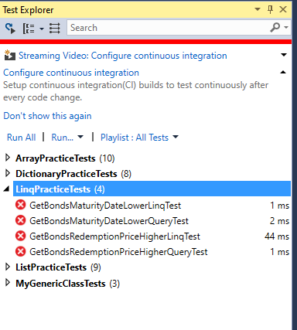
linq
Practice 6
Provide implementations for methods in LinqPractice
After methods have been filled in with implementation unit tests from LinqPracticeTests
should no longer fail

Slide 55
linq
Practice 5 - solution
public static class LinqPractice {
public static IEnumerable<Bond> GetBondsRedemptionPriceHigherQuery(IEnumerable<Bond> bonds, double redemptionPrice) {
return from bond in bonds
where bond.RedemptionPrice > redemptionPrice
select bond;
}
public static IEnumerable<Bond> GetBondsRedemptionPriceHigherLinq(IEnumerable<Bond> bonds,double redemptionPrice) {
return bonds.Where(b => b.RedemptionPrice > redemptionPrice);
}
public static IEnumerable<Bond> GetBondsMaturityDateLowerQuery(IEnumerable<Bond> bonds, DateTime maturityDate) {
return from bond in bonds
where bond.MaturityDate < maturityDate
select bond;
}
public static IEnumerable<Bond> GetBondsMaturityDateLowerLinq(IEnumerable<Bond> bonds, DateTime maturityDate) {
return bonds.Where(b => b.MaturityDate < maturityDate);
}
}

Slide 56
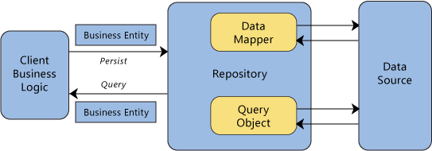
Repository pattern
Notes:
In many applications, the business logic accesses data from data stores such as databases, SharePoint lists, or Web services. Directly accessing the data can result in the following:
Duplicated code
A higher potential for programming errors
Weak typing of the business data
Difficulty in centralizing data-related policies such as caching
An inability to easily test the business logic in isolation from external dependencies
Use the Repository pattern to achieve one or more of the following objectives:
You want to maximize the amount of code that can be tested with automation and to isolate the data layer to support unit testing.
You access the data source from many locations and want to apply centrally managed, consistent access rules and logic.
You want to implement and centralize a caching strategy for the data source.
You want to improve the code's maintainability and readability by separating business logic from data or service access logic.
You want to use business entities that are strongly typed so that you can identify problems at compile time instead of at run time.
You want to associate a behavior with the related data. For example, you want to calculate fields or enforce complex relationships or business rules between the data elements within an entity.
You want to apply a domain model to simplify complex business logic.
Increase testability: Repository systems are good for testing. One reason being that you can use Dependency Injection. Basically, you create an interface for your repository, and you reference the interface for it when you are making the object. Then you can later make a fake object (using moq for instance) which implements that interface. Using something like StructureMap you can then bind the proper type to that interface. Boom you’ve just taken a dependence out of the equation and replaced it with something testable.

Slide 57
Database transactions & using
…
var _holdingRepository = new HoldingRecordRepository();
…
using (ITransaction transaction = session.BeginTransaction()) {
…
_holdingRepository.Session = session;
_holdingRepository.Save(holdingRecord);
…
}
Notes:
Using
Provides a convenient syntax that ensures the correct use of IDisposable objects.
Idisposable - The primary use of this interface is to release unmanaged resources. The garbage collector automatically releases the memory allocated to a managed object when that object is no longer used. However, it is not possible to predict when garbage collection will occur. Furthermore, the garbage collector has no knowledge of unmanaged resources such as window handles, or open files and streams.
Use the Dispose method of this interface to explicitly release unmanaged resources in conjunction with the garbage collector. The consumer of an object can call this method when the object is no longer needed.
When the lifetime of an IDisposable object is limited to a single method, you should declare and instantiate it in the using statement. The using statement calls the Dispose method on the object in the correct way, and (when you use it as shown earlier) it also causes the object itself to go out of scope as soon as Dispose is called.

Slide 58
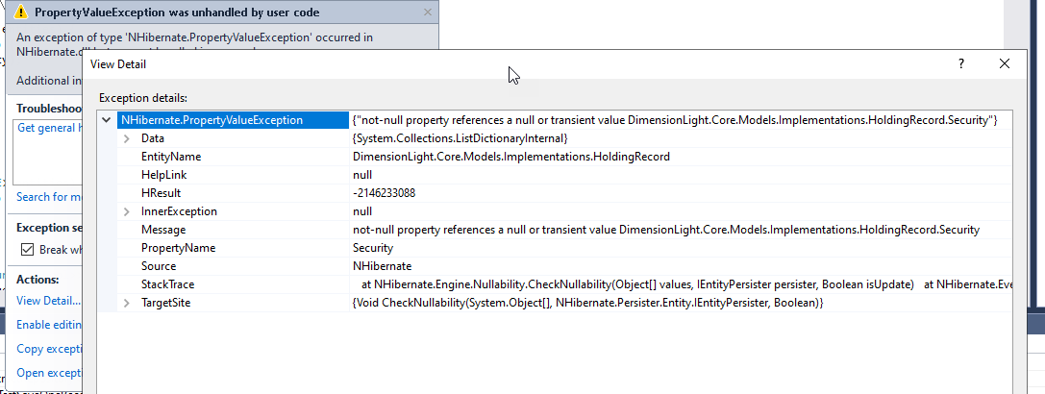
references to null or transient value error

Slide 59
Homework

